Slide 1
Client Name 1
Notes:
This presentation is being presented by WEX. My name is ____________ and I am happy to be here with you today!

Slide 2
Health reimbursement arrangement (HRA)
Notes:
During our presentation today, I will be reviewing what a health reimbursement arrangement, or HRA, is and why you should consider enrolling in an HRA.

Slide 3
What is a health reimbursement arrangement (HRA)?
Designed and funded by your employer
Can offset costs not covered by your group health plan
Notes:
A health reimbursement arrangement (or HRA) is a benefits plan that reimburses you for eligible expenses to help offset costs not covered by your group health plan.
What makes an HRA different from a Health Savings Account or a Flexible Spending Account is that an HRA is entirely funded by your employer. Because of this, your involvement in an HRA does not count against your taxable income.
After your employer contributes funds to your HRA, you can start spending those funds on eligible expenses, set by your employer’s plan design.
Unused amounts cannot be cashed out. Your employer may have a rollover amount, where a portion of the funds can be carried over to the next year’s plan.

Slide 4
HRAs are customizable
How your HRA plan functions is determined by your employer
When funds are contributed to the plan and when the funds are available
What expenses are eligible for reimbursement
Notes:
Because HRAs are so customizable, no two plans look the same! Here are some of the ways your employer could customize the design of an HRA.
Your employer has control over how much they contribute to the plan and whether any funds carry over to the next plan year.
Your employer also determines when contributions become available. This could be 100% at the beginning of the plan year, scheduled throughout the year, or after criteria has been met, like hitting a deductible.
Your employer also determines the expenses eligible for reimbursement. Depending on the HRA’s eligible expenses, you may or may not be able to participate in a Health Savings Account (HSA).
Be sure to ask a representative from your human resources team for the specifics of your HRA plan.

Slide 5

What does your HRA cover?
Eligible expenses are determined by your employer but may include expenses such as:
Insert eligible expense
Insert eligible expense
Notes:
***Insert eligible expenses for this client’s specific HRA
Your employer also determines what expenses are eligible for reimbursement. Check out the list on the screen to see some of the items eligible for reimbursement through your HRA.

Slide 6

Your HRA Threshold
Once you pay the predetermined deductible amount, your HRA funds can pick up the remainder.
Deductible amounts
Employee: ####
Family: ####
Notes:
****If the client has a threshold HRA can use this slide and modify to what your client has.
Your employer has designed your HRA with a threshold. It works like this: you pay the first portion of your healthcare expenses, up to an amount pre-determined by your employer. This is called the deductible. After the deductible has been paid, the HRA picks up the remainder.
The deductible amounts for your HRA are $xxx for an employee only, or $xxxx if your whole family is covered by the HRA.

Slide 7
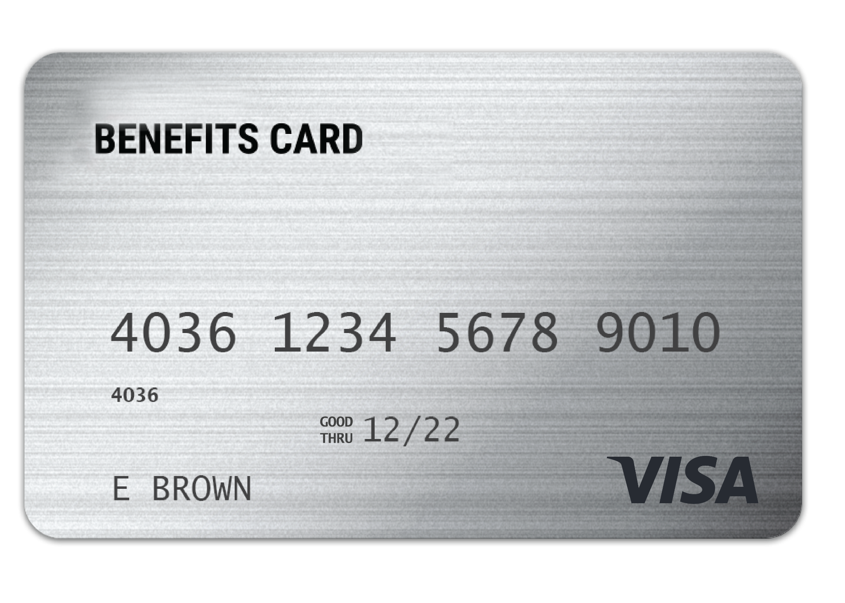
WEX benefits card
Free benefits card
Minimize the amount of out-of-pocket spending
Valid for three+ years
Instant access to plan funds
Notes:
Your enrollment in any of our plans includes our free benefits debit card. This allows you to easily access your funds right from your wallet to help you minimize the amount of out of pocket spending.
If you already have our debit card, they are good for three years, so if you received one within the last two years you will not get a new one again next year. We will mail you a new debit card 90 days before the expiration date of your current debit card. All new cards will be good for four years.
Regardless if you are enrolled in an HRA or another of our benefit plans, you will use the same card.
If your card is lost or stolen, you can order a new card free of charge from the benefits mobile app or by going through your online account.
You can request a WEX benefits debit card for your dependents and/or spouse. First ensure they are added to your online account. You can do that by going to the Profile section of your online account. Once they are added you can select Banking/Cards and request a card for each dependent. A dependent must be 18 years of age or older to receive a debit card.
The WEX Benefits Debit Card is the most common way that claims against your HRA are filed.

Slide 8

Claim filing
The best form of documentation when submitting a claim is either an explanation of benefits (EOB) from your carrier, or an itemized receipt from your provider
Any documentation provided must contain the following information:
  When the service was received
  Where the service was received
  What service was received
  The amount/cost of the service received
  Who received the service
Notes:
Let's talk a bit about documentation! (say jokingly) Everyone loves providing documentation, right?
Now, there are instances where we will reach out to you requesting documentation for your debit card purchase. This is not because we want to keep bothering you, it is because it is an IRS regulation.
Also, if you are submitting a claim via your mobile app, your online account or manually via the mail the best form of receipt or documentation is an Explanation of Benefits as it contains all of the necessary information for WEX to approve your claim. You receive your explanation of benefits (or EOB) from your medical, dental or vision carriers.
Any documentation provided must contain the following information:
When the service was received
Where the service was received
What service was received
The amount/cost of the service received
Who received the service

Slide 9


Claim filing options
^{Mobile app, online account}
^{or manual claims}
Processed within two business days
Choose direct deposit or paper check
^{Direct deposit – FREE}
^{$25 minimum reimbursement}
^{for paper checks}
Notes:
For anything you’ve paid out of pocket, you can also submit claims to be reimbursed by using your mobile app – simply login, select File a Claim and use the easy to follow steps. You can even take a picture of your explanation of benefits or itemized receipt right from your mobile phone!
And of course you can submit a claim thru you online account by following similar steps and uploading your documentation or by submitting the Claim form.
All claims are processed within 2 business days. You can choose to be reimbursed thru direct deposit right to your bank account or have a check mailed to you. Direct deposit is provided free of charge and is a quick and easy way to get your reimbursement!

Slide 10


Account access
^{Online account}
^{Mobile App}
Notes:
Now let’s end with a highlight of how you can access all of your accounts with us–
You can get access to information about your account by logging into your online account, downloading the WEX Benefits mobile app or calling our Participant Services department.

Slide 11
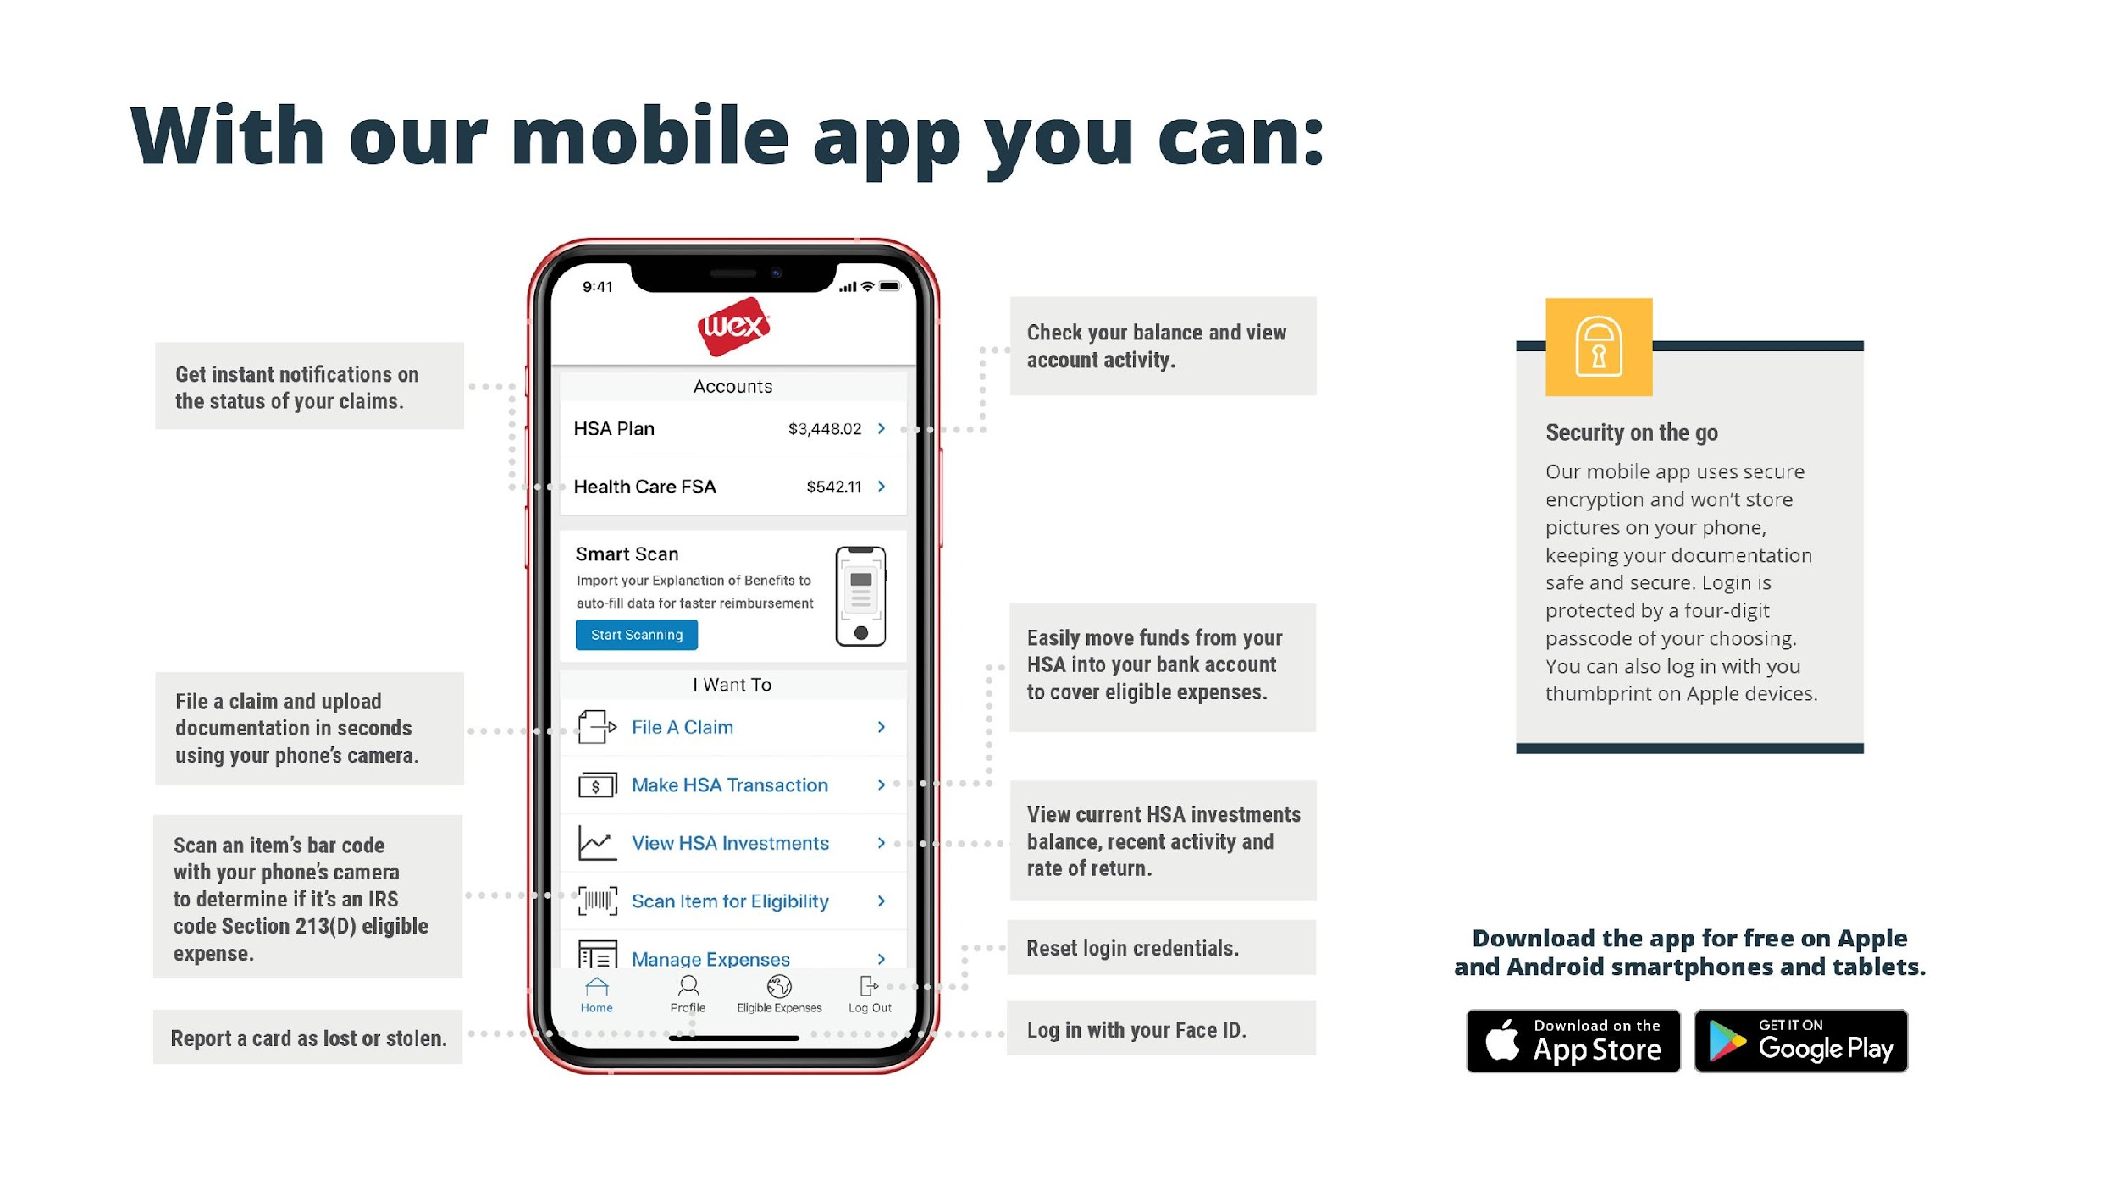

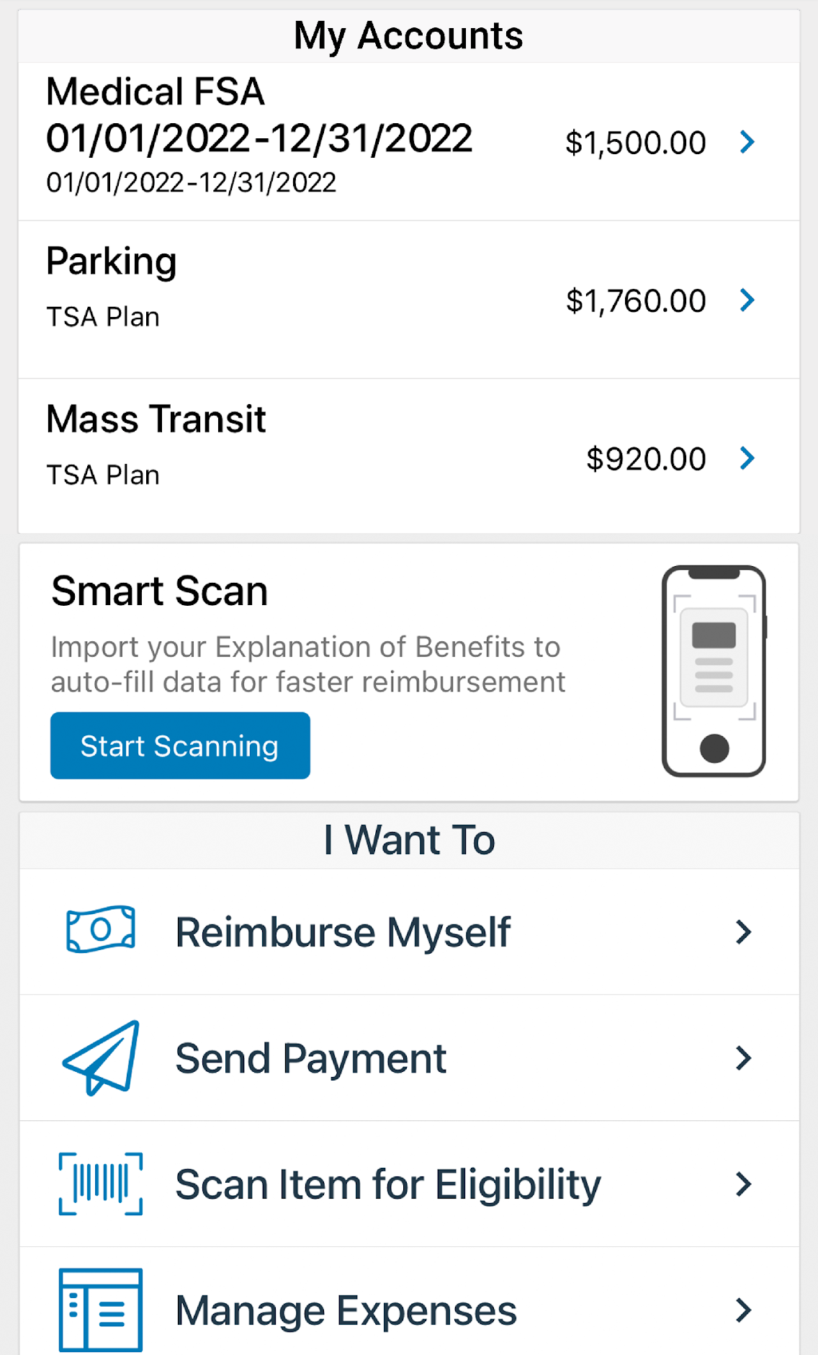
With our mobile app you can:
Security on the go
Our mobile app uses secure encryption and won’t store pictures on your phone, keeping your documentation safe and secure. Login is protected by a four-digit passcode of your choosing. You can also log in with your thumbprint on Apple devices.
Notes:
The WEX mobile app provides you with quick easy access to your online account. After logging in the first time, you can set up fingerprint access right from your phone.
Other great features include:
An eligible expense scanner – scan barcodes of items to see if they qualify as an eligible expense. {Some employers have disabled this feature, check before including this line}
Take a photo of your explanation of benefits or itemized receipt in order to submit documentation for any outstanding claims. This saves a ton of time since you don’t have to scan an email receipt and upload it manually.
Easily check your account balance while standing in line at the store, making it easy to decide if I want to use my HRA dollars to cover a purchase.

Slide 12



Contact Participant Services
Our Participant Services team is available Monday through Friday, from 6 a.m. to 9 p.m. CT, except holidays.
^{Live Chat}
^{Email}
^{Phone}
^{customerservice@wexhealth.com}
⁸⁶⁶⁻⁴⁵¹⁻³³⁹⁹
Notes:
Our participant services team is available to you Monday through Friday from 6 am to 9 pm Central time
You have a variety of options when contacting us.
You can use the CHAT feature from our website by logging into your online account.
You can email us
Or call us and check your balance using the automated system.

